Slide 1
GETTING STARTED
Let’s jump in – wheeeeeeee!

Slide 2



Installing Ionic
To install Ionic, we need to have NodeJS installed
https://nodejs.org/en/
Download and run the current version
Open Command Prompt to install Ionic using NodeJS
npm install –g ionic cordova
This is called a Command Line Interface or CLI for short

Slide 3

Starting a new project
We start a new Ionic project in two very simple steps
Open Command Prompt
Type, ionic start [project name] tabs
The CLI will place your app in the folder your Command Prompt is open in at the time the command is run.
To change, type cd C:\Folder BEFORE, running your ionic start command
You can see a full list of Ionic commands by typing ionic in the command line

Slide 4
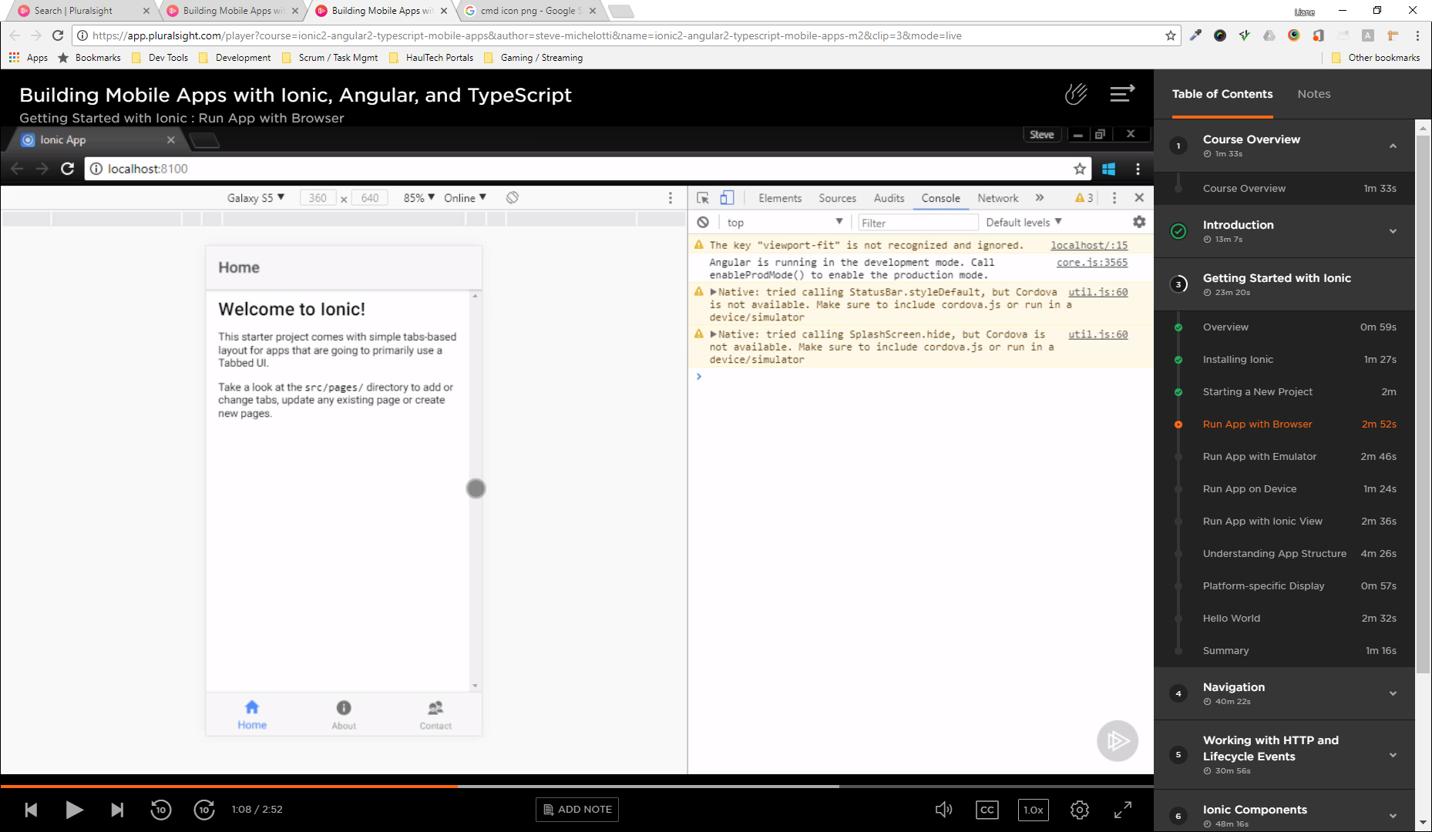
Run application in the browser
We can already see what our new app looks like using the command ionic serve
This opens your default browser to http://localhost:0000 and displays your mobile app
If we press F12 and click the Mobile View Toggle we can see the app as on your favoured mobile device.

Slide 5
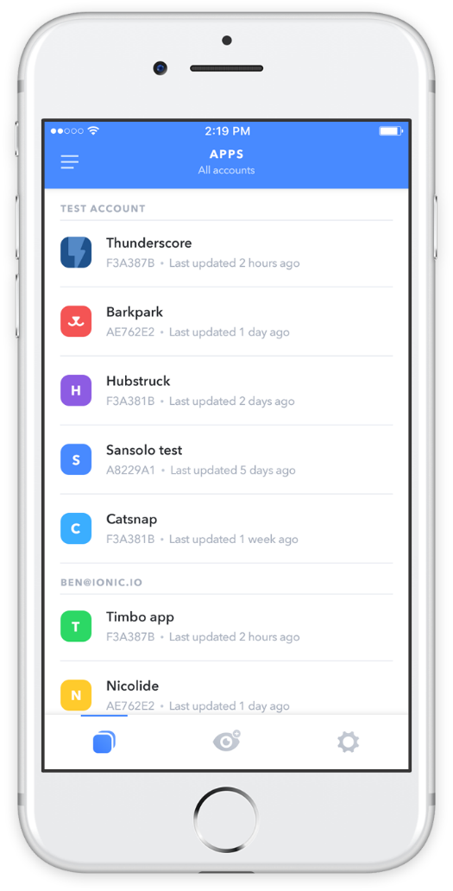
Run application on a mobile
You may need to run your application on a mobile device for things like:
Using the camera
Scanning QR or Barcodes
Accessing anything else that uses features native to the phones OS
We can find out how to do this at: https://ionicframework.com/pro/view

Slide 6

Argh! What’s all these files and folders?
Even a small mobile app has a large folder structure, it’s not as confusing as it first seems.
The src folder is where it’s all at. This is the folder we’re going to live in when developing our app.
The whole app runs from a single page, index.html, using the <ion-app> tag as a container.
The app folder is our starting point and contains all our configuration:
Sections (or modules)
Plug-ins
Services
Etc.
The pages folder is each section we create and each has three parts:
HTML (.html) – Front-end
CSS (or SCSS) - Styling
TypeScript (.ts) – Back-end
The www folder contains very little now, but when we build our app, it will be stored here.
Any assets we use in our app should be copied in the assets folder.

Slide 7
CHALLENGE TIME!
Get started and install both NodeJS and Ionic.
Create your own starter application
Run it in mobile mode on the browser
Share a screenshot with us on our Discord server.

